Slide 1
Webots Seminar
Wonse Jo
jow@purdue.edu
SMART LAB

Slide 2

Contents
Introduction of Webots
Section 1: Create World and import Robot
Create new world
Import existing Robot platform
Insert obstacles
Control motor velocity
Section 2: Reading keyboard
Read Keyboard
Robot control
Brake time (5 min)
Section 3: Reading sensor
Read and display distance sensor data
Robot control with random walking
Section 4: Apply algorithm
Read mouse position
Apply position control algorithm

Slide 3
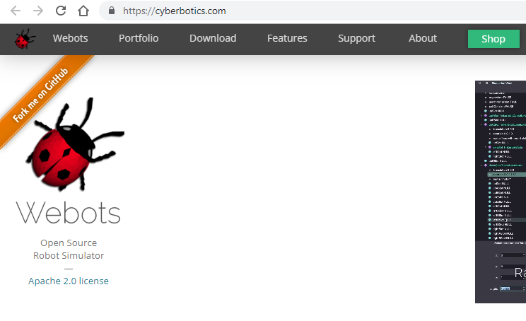
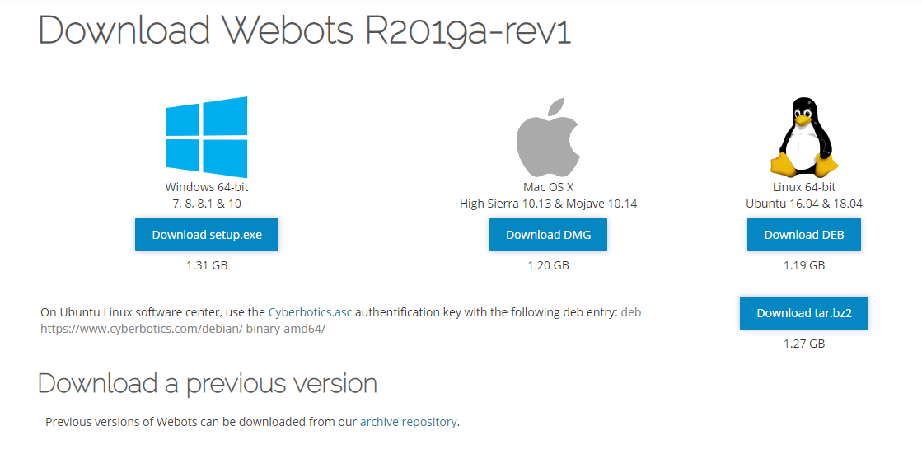
Download Webots
Download Webots from https://cyberbotics.com/download
Version R2019-revv1 : Window or Ubuntu

Slide 4
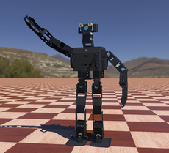
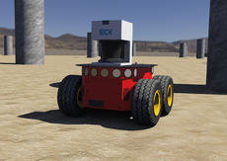
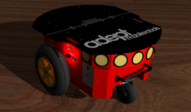
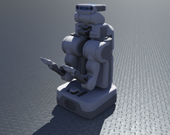
Introduction of Webots
Webots?
Open Source Robot Simulator
provides a complete development environment to model, program and simulate robots.
well documented and continuously maintained since 1996
Thousands of institutions worldwide use it for R&D and teaching.
used in industry, education and research
Initially developed by Dr. Olivier Michel at the Swiss Federal Institute of Technology (EPFL) in Lausanne, Switzerland in 1996

Slide 5
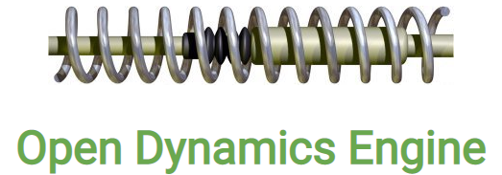
Introduction of Webots
Webots?
Open Dynamics Engine (ODE)
For detecting of collisions and simulating rigid body dynamics.
Allows to accurately simulate physical properties of objects such as velocity, inertia, and friction.
Robot controller programs written by C, C++, Python, ROS, Java, and MATLAB.
There are a number of examples in the program or Website

Slide 6
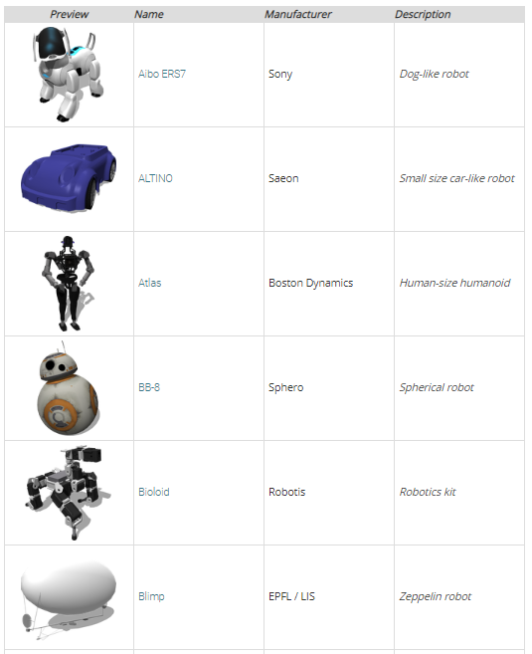
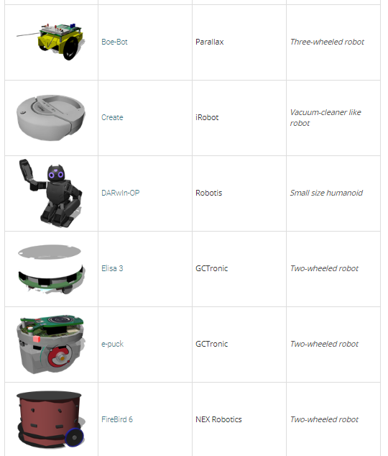
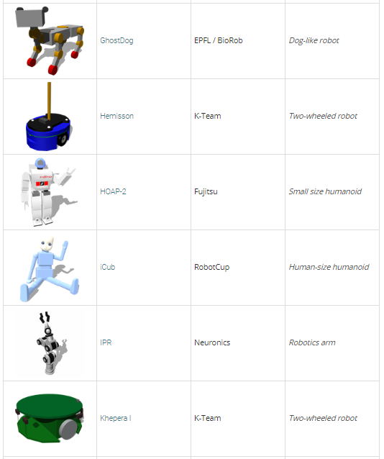
Introduction of Webots
Webots?
Included 45 Robot Models: https://cyberbotics.com/doc/guide/robots

Slide 7
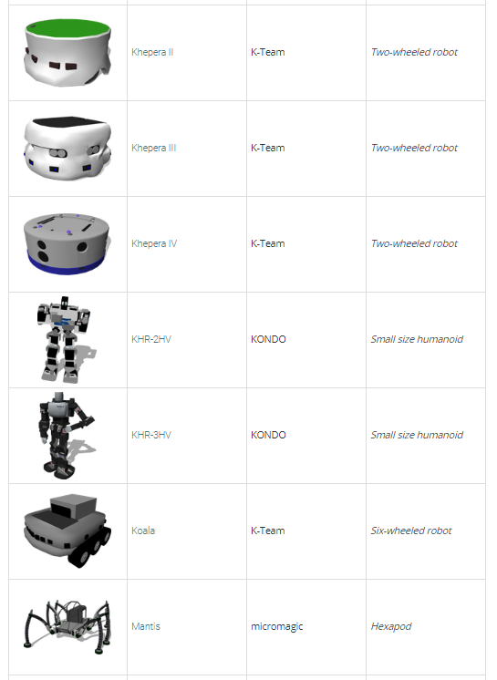
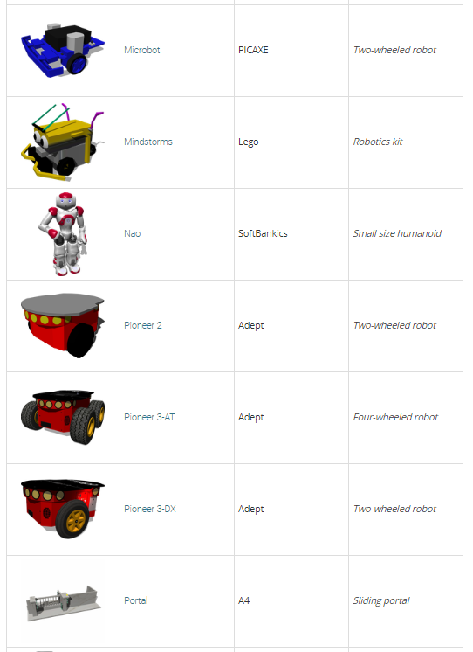
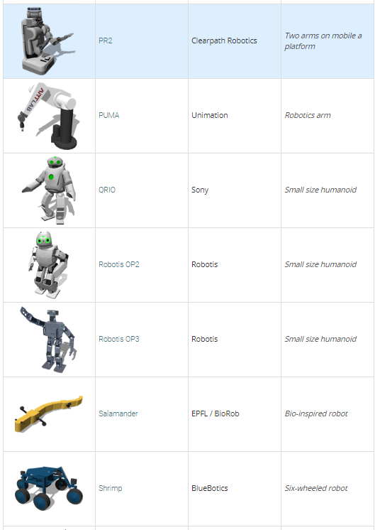
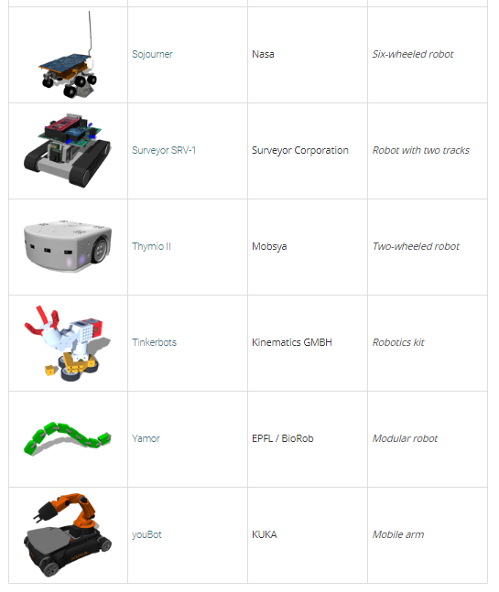
Introduction of Webots
Webots?
Included 45 Robot Models: https://cyberbotics.com/doc/guide/robots

Slide 8
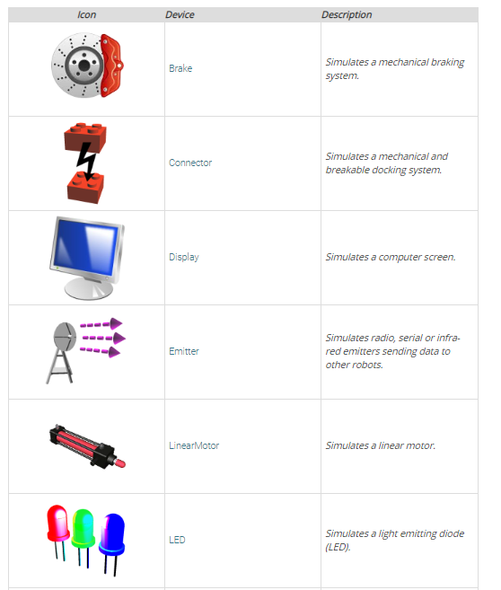
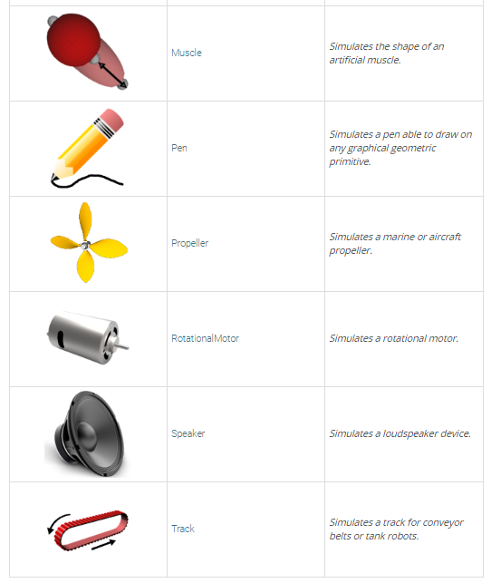
Introduction of Webots
Webots?
Included 12 Acuator Models: https://cyberbotics.com/doc/guide/robots

Slide 9
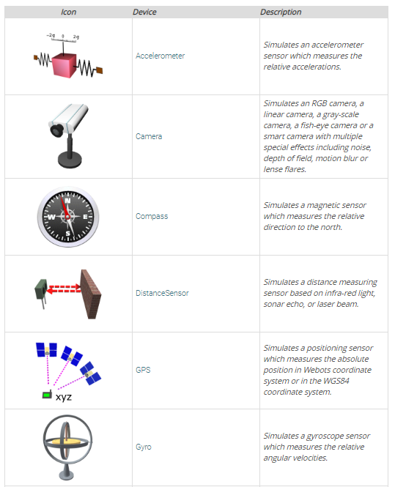
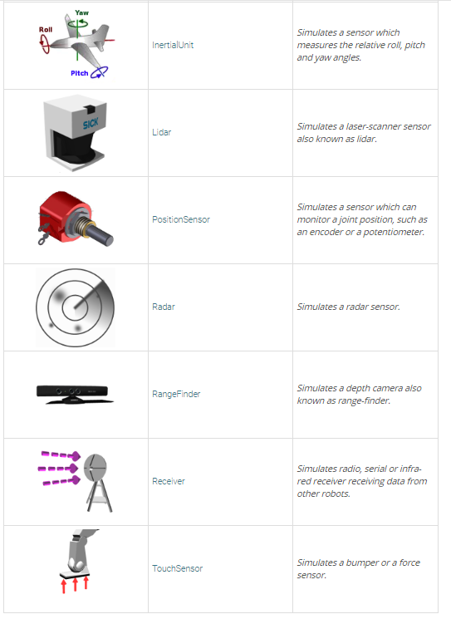
Introduction of Webots
Webots?
Included 26 Sensor Models: https://cyberbotics.com/doc/guide/robots

Slide 10
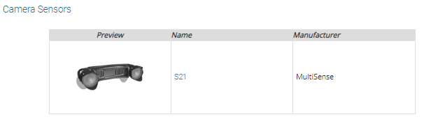
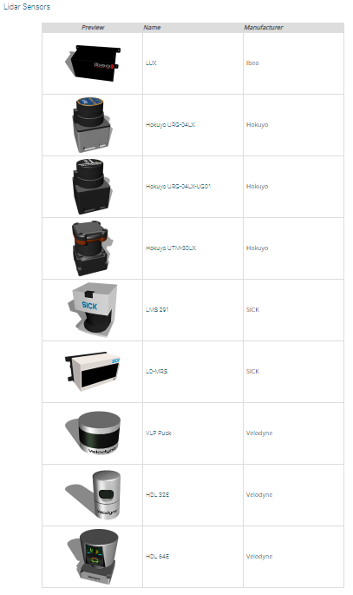
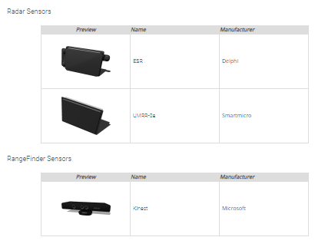
Introduction of Webots
Webots?
Included 26 Sensor Models: https://cyberbotics.com/doc/guide/robots

Slide 11
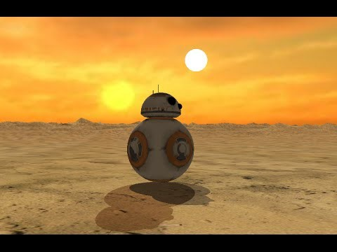
Introduction of Webots
Sphero's BB-8 robot model in Webots

Slide 12
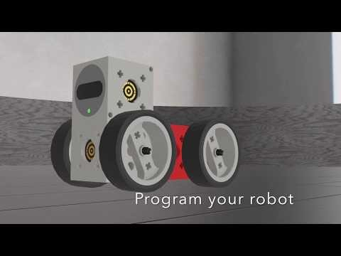
Introduction of Webots
Tinkerbots in Webots

Slide 13
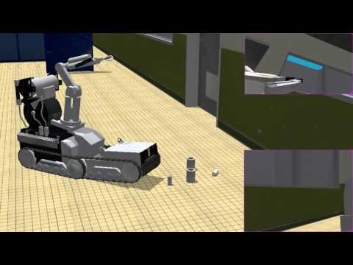
Introduction of Webots
Katana Robot Arm

Slide 14
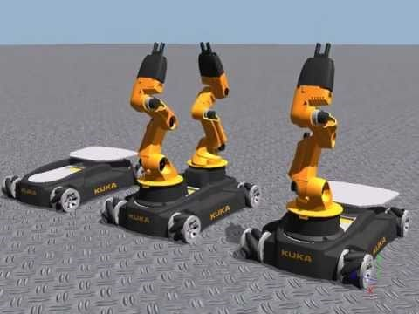
Introduction of Webots
KUKA's youBot

Slide 15
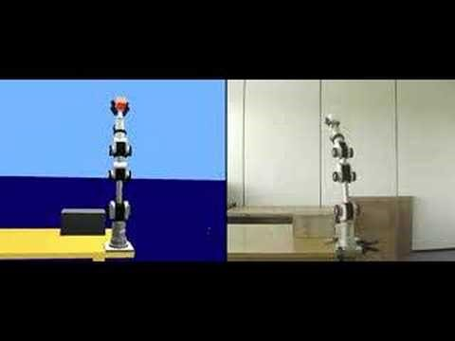
Introduction of Webots
Real vs Simulation

Slide 16
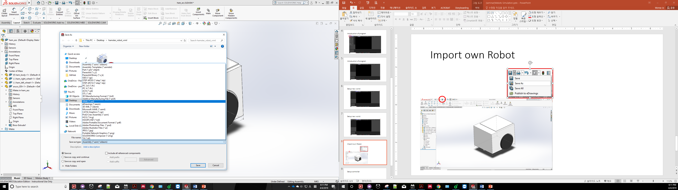
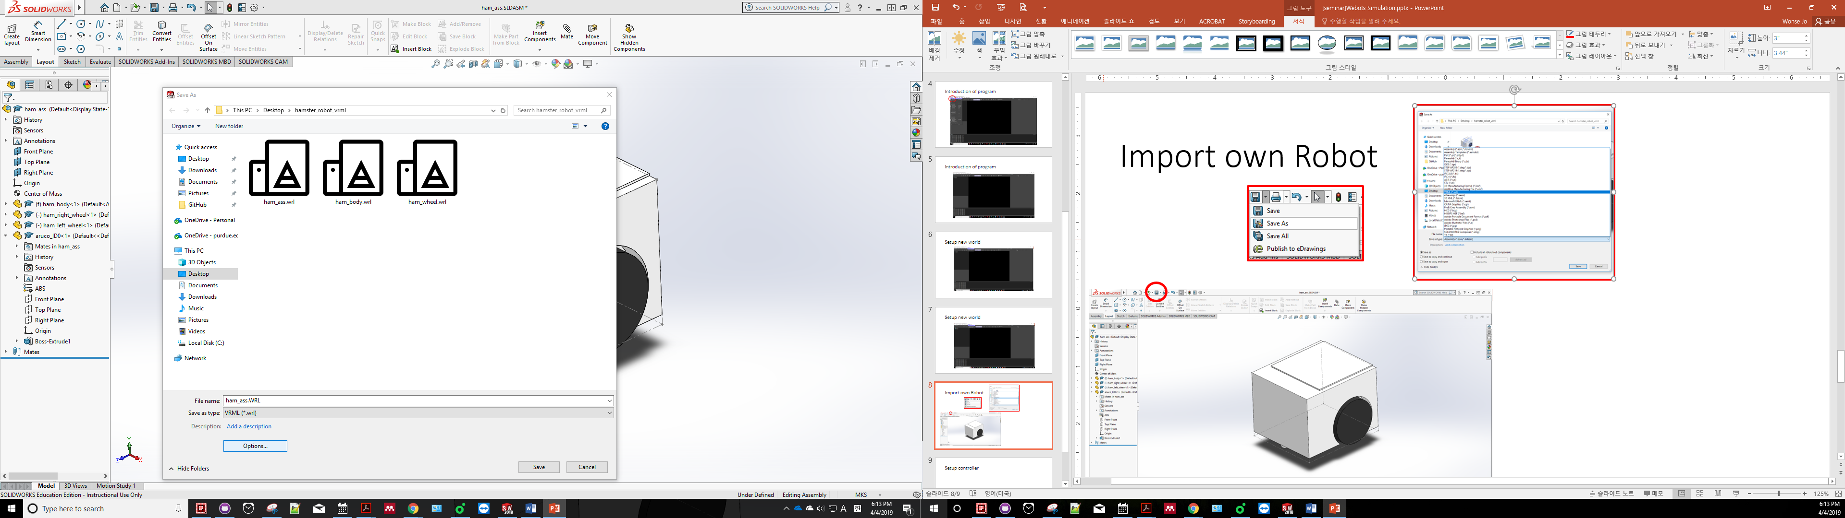
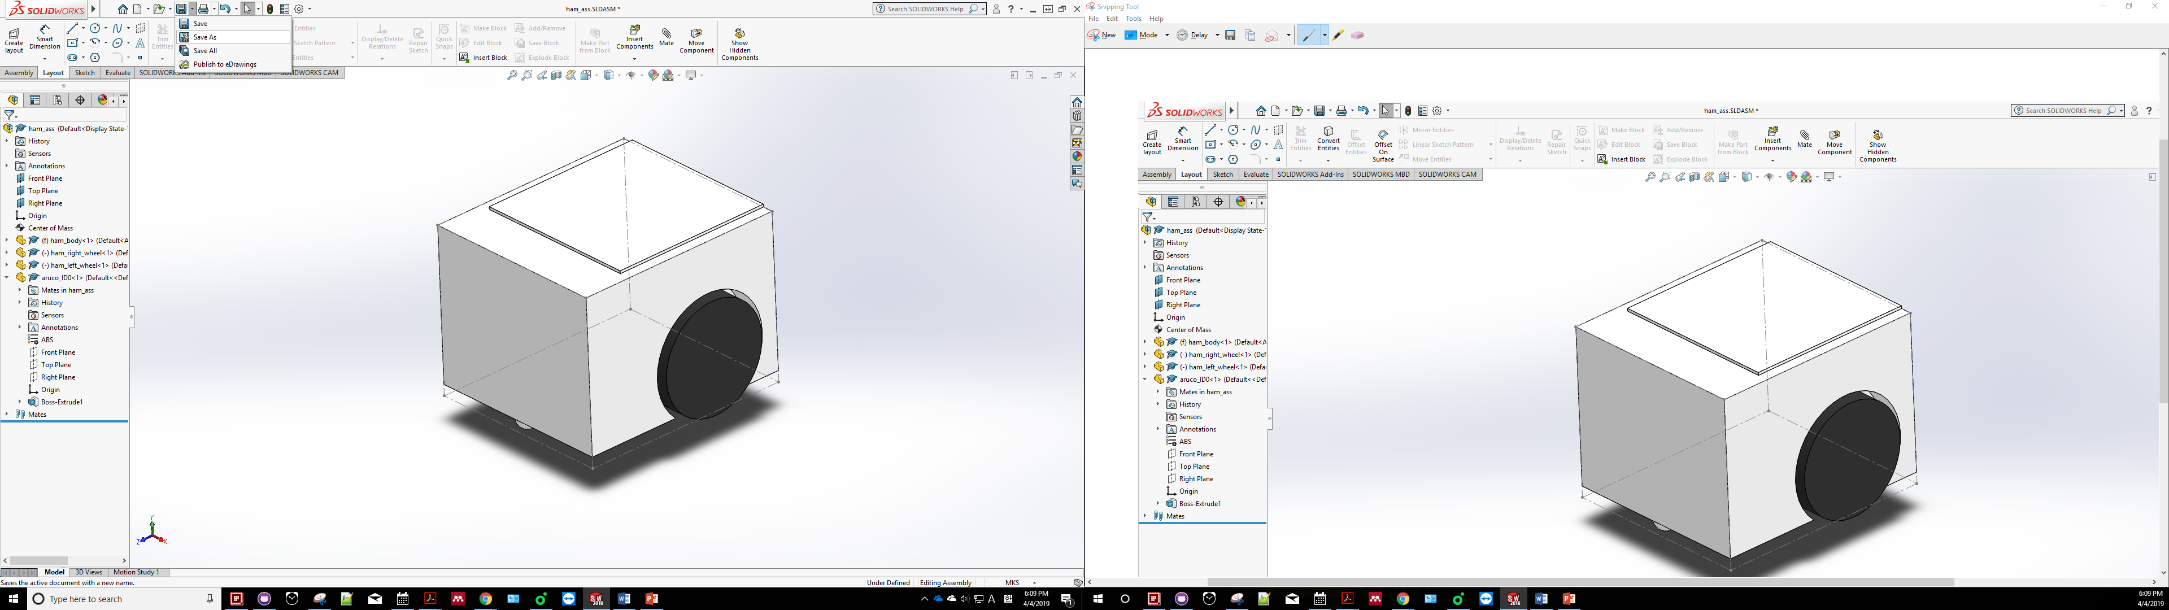
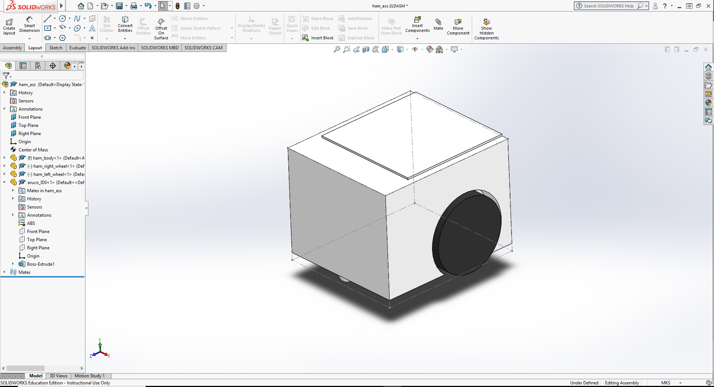
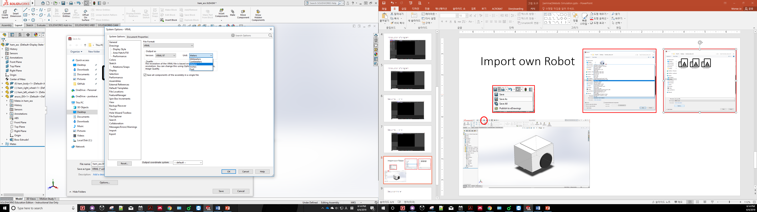
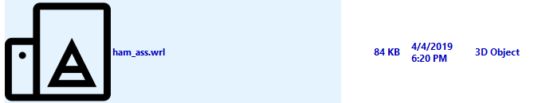
Import VRML File
Click the option
Select VRML format
Setup the output as
version = VRML 97,
Unit = Meter
- Result
Need to save as VRML files from 3D design Program

Slide 17
Section 1
Create World and import Robot

Slide 18
Section 1: Create World and import Robot
Run the Webots Program
Create New World for first simulation
Click the Wizard
Create “a Webots Project directory”
Change a name for project
Change a name for the new world

Slide 19
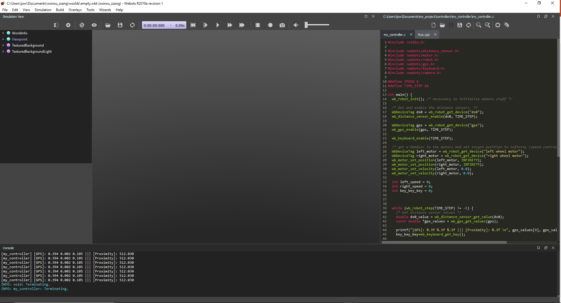
Section 1: Create World and import Robot
Add a new
Reload
Pause
Change Viewpoint
Save
Play
Scene Tree
3D Window
Text editor
Console

Slide 20
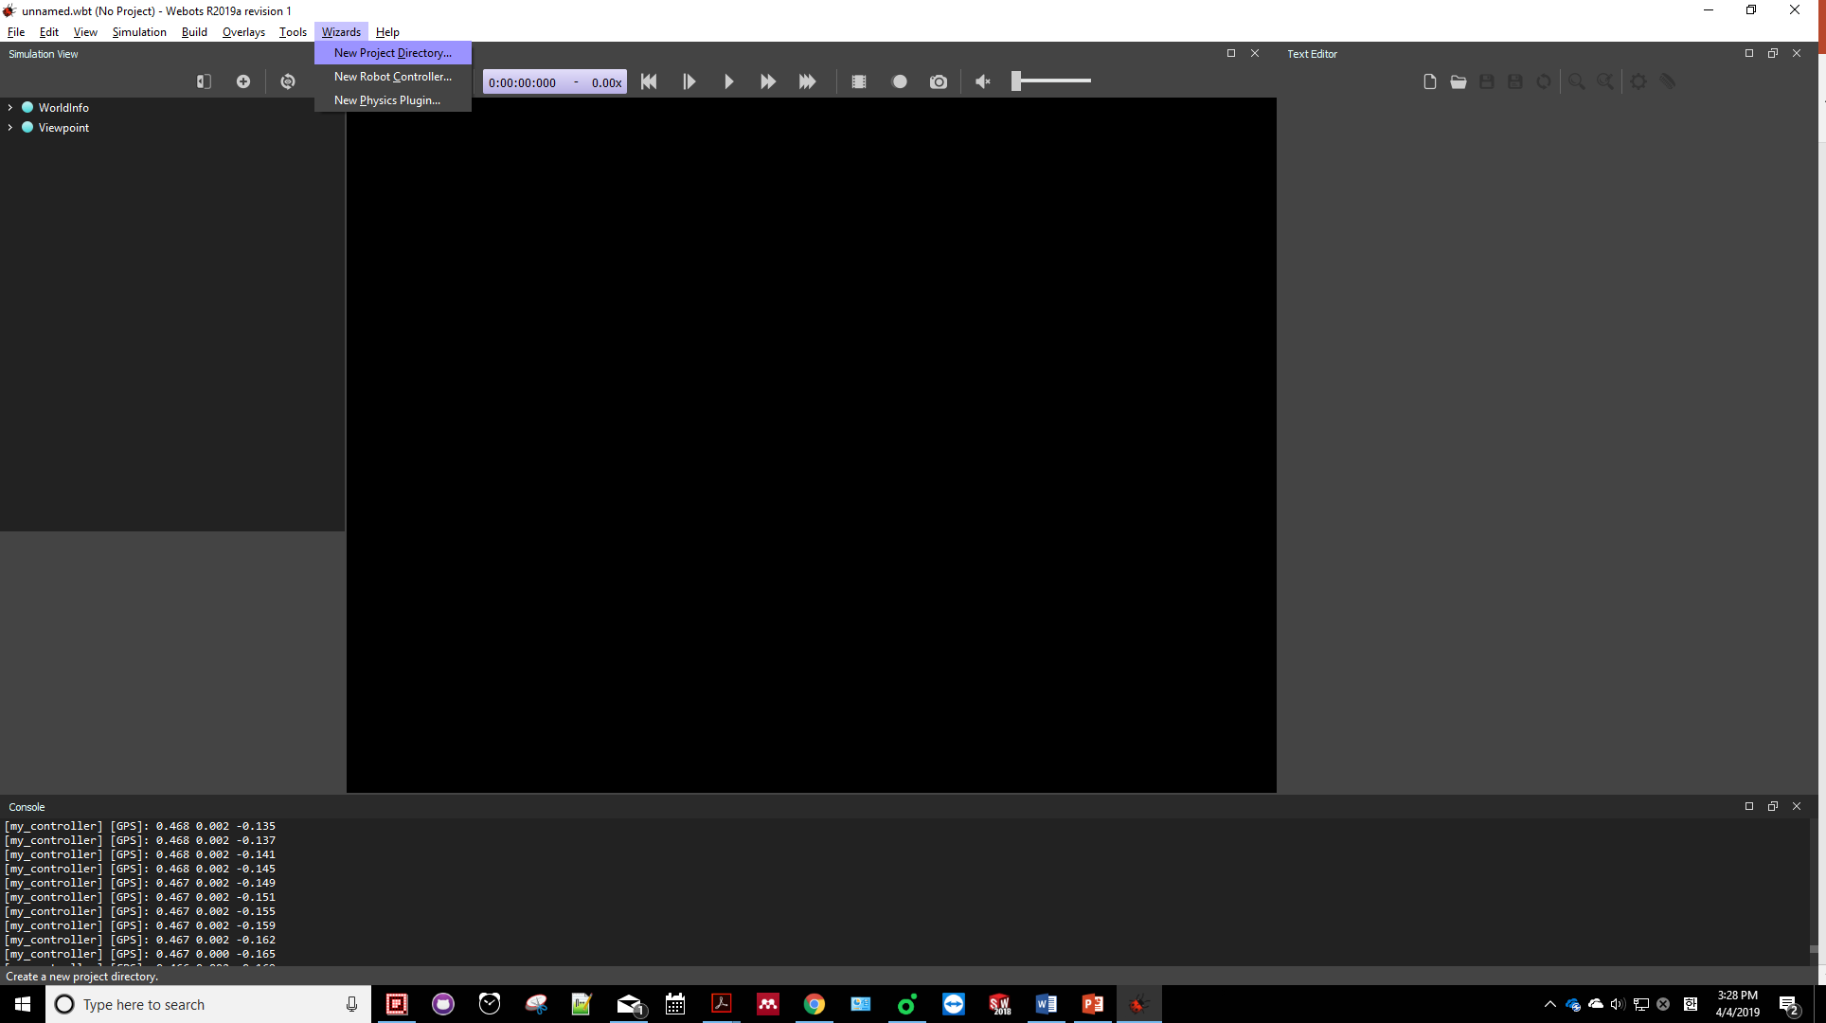
Section 1: Create World and import Robot

Slide 21
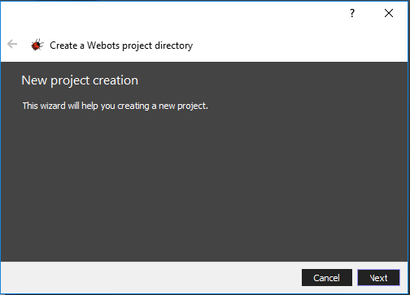
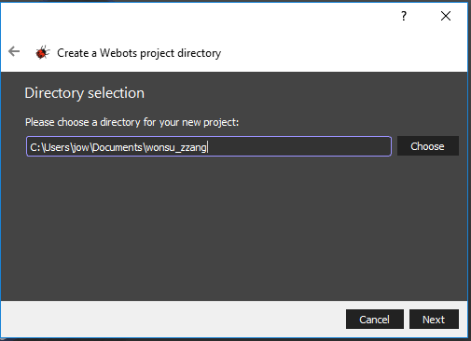
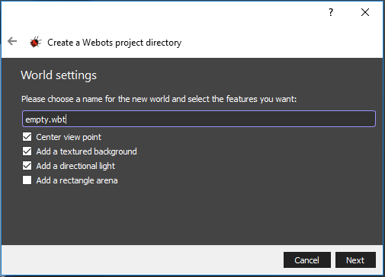
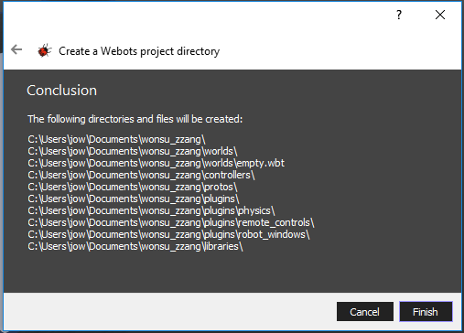
Section 1: Create World and import Robot

Slide 22
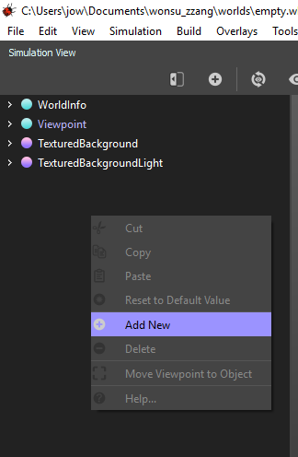
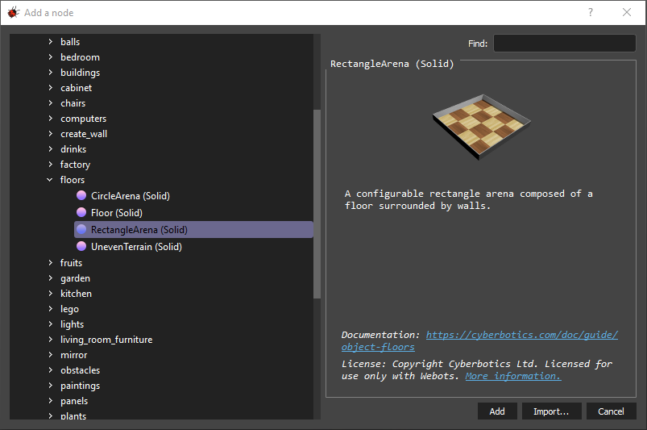
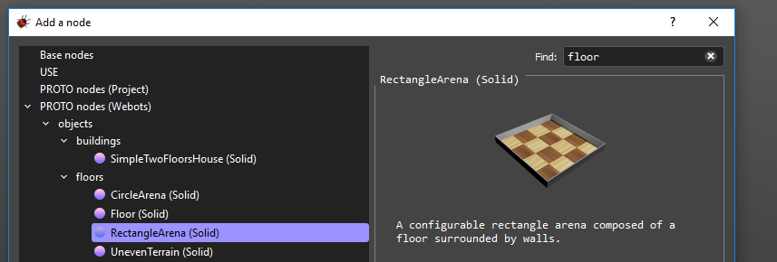
Section 1: Create World and import Robot
Import New robot and Obstacles
Add “RectangleArena”
Add New -> PROTO nodes -> objects -> floors -> RectangleArena (Solid)
Or search “floor”

Slide 23
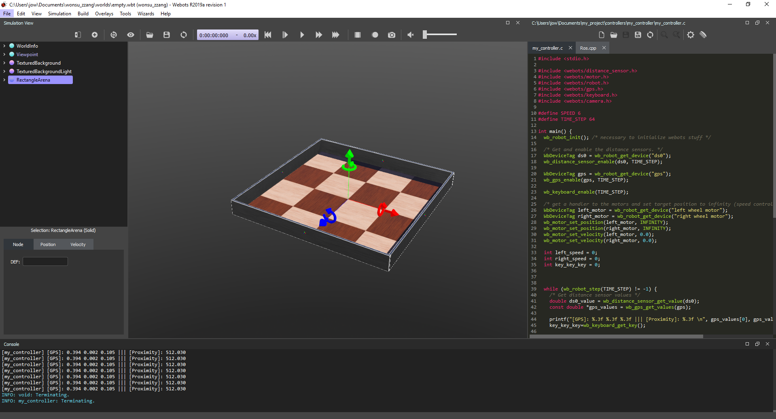
Section 1: Create World and import Robot

Slide 24
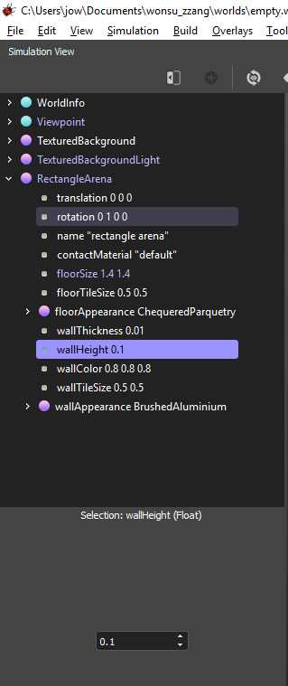
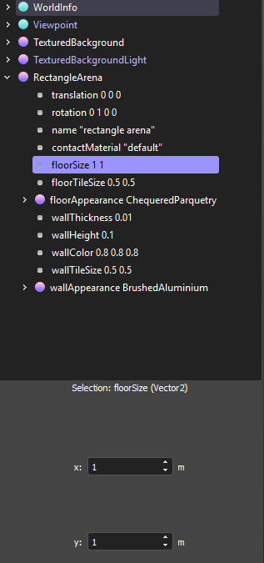
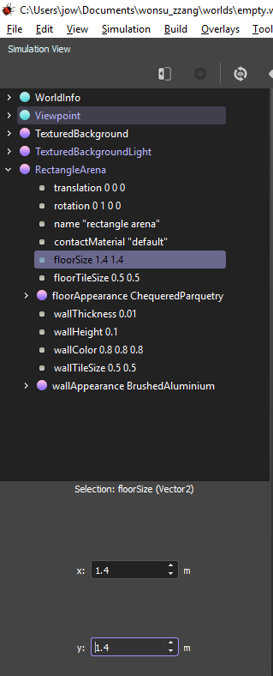
Section 1: Create World and import Robot
Modify the size of the floor
enter “1” in x and y
Modify the height of the wall

Slide 25
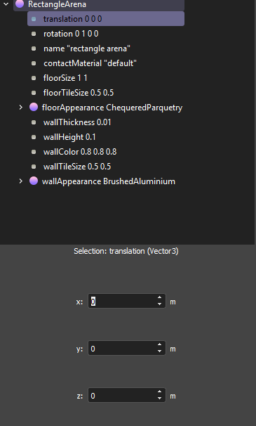
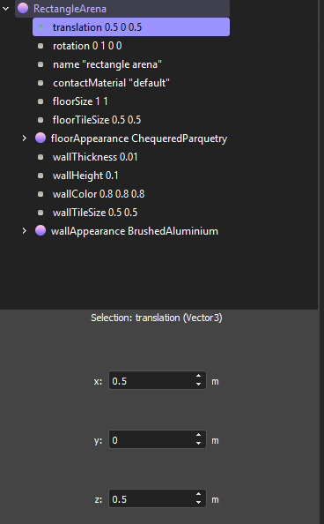
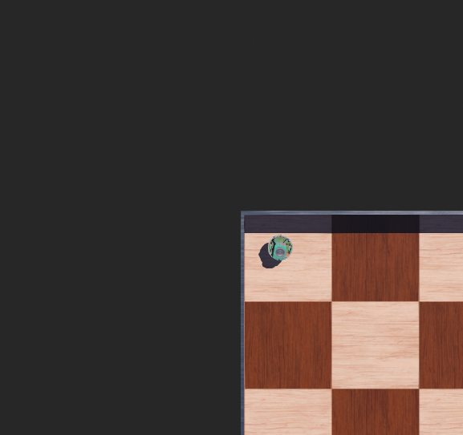
Section 1: Create World and import Robot
Modify the translation
enter “0.5, 0, 0.5”

Slide 26
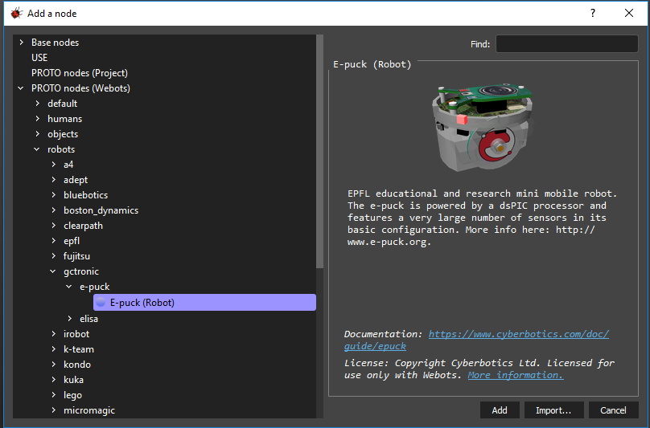
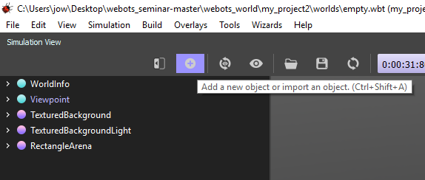
Section 1: Create World and import Robot
Add e-Puck Robot
PROTO nodes(Webots)/robots/gctronic/e-puck

Slide 27


Section 1: Create World and import Robot
Setup DEF to make global variable
Edit “e-puck” for controller code

Slide 28



Section 1: Create World and import Robot
Add the cardboardBox in the world

Slide 29



Section 1: Create World and import Robot
Modify the size of the box
Y-axis
X-axis
Z-axis

Slide 30



Section 1: Create World and import Robot
Move the box
(1) Drag the box with shift key
Or (2) Edit desire position
Y-axis
X-axis
Z-axis

Slide 31


Section 1: Create World and import Robot
Add mass “1”
the box will drop into the floor

Slide 32

Section 1: Create World and import Robot
Apply Force via mouse drag
Click one of surface of the imported box
Click the mouse left button with Alt key
Then, drag

Slide 33
Section 2
Basic robot control

Slide 34

Section 2: Basic robot control
In section 2, we will
Read keyboard data
Control robot via keyboard

Slide 35


Section 2: Basic robot control
Introduce e-Puck Robot
Go to https://cyberbotics.com/doc/guide/robots
Search “e-Puck”

Slide 36
Section 2: Basic robot control
Procedures for controller programing
Define Name:
Ex) WbDeviceTag motor_wonsu
Setup device property
Ex) wb_motor_set_velocity()
Read variables
Ex) wb_motor_get_device()
int variable;
WbDeviceTag
Get data from node
A = function();
A = wb_motor_get_device()
Define Name
Set variables on node
void functions();
wb_motor_set_device();

Slide 37







Section 2: Basic robot control
Create a New controller using Wizards
Click the Wizard -> New Robot Controller -> Select C Language -> edit name
Import this controller into e-Puck controller Node

Slide 38

Section 2: Basic robot control
Control Motor velocity

Slide 39




Section 2: Basic robot control
Refer “Nodes and API Functions”
https://www.cyberbotics.com/doc/reference/nodes-and-api-functions
Search “Motor”
Go to Velocity control

Slide 40
Section 2: Basic robot control
Control Motor velocity (Left Motor)
#include <stdio.h>
#include <stdlib.h>
#include <webots/robot.h>
#include <webots/motor.h>
#define TIME_STEP 64
#define MAX_SPEED 6.28
int main(int argc, char **argv)
{
/* necessary to initialize webots stuff */
wb_robot_init();
// get the motor devices
WbDeviceTag left_motor = wb_robot_get_device("left wheel motor");
// set the target position of the motors
wb_motor_set_position(left_motor, INFINITY);
wb_motor_set_velocity(left_motor, 0);
/* main loop
* Perform simulation steps of TIME_STEP milliseconds
* and leave the loop when the simulation is over
*/
while (wb_robot_step(TIME_STEP) != -1) {
wb_motor_set_velocity(left_motor, MAX_SPEED);
};
/* Enter your cleanup code here */
/* This is necessary to cleanup webots resources */
wb_robot_cleanup();
return 0;
}

Slide 41


Section 2: Basic robot control
Control Motor velocity
Before compiling controller, recommend to save the world

Slide 42


Section 2: Basic robot control
Control Motor velocity
(Q1) Add “MAX_SPEED” to the right motor

Slide 43
Section 2: Basic robot control
Control Motor velocity
#include <stdio.h>
#include <stdlib.h>
#include <webots/robot.h>
#include <webots/motor.h>
#define TIME_STEP 64
#define MAX_SPEED 6.28
int main(int argc, char **argv)
{
/* necessary to initialize webots stuff */
wb_robot_init();
// get the motor devices
WbDeviceTag left_motor = wb_robot_get_device("left wheel motor");
WbDeviceTag right_motor = wb_robot_get_device("right wheel motor");
// set the target position of the motors
wb_motor_set_position(left_motor, INFINITY);
wb_motor_set_position(right_motor, INFINITY);
wb_motor_set_velocity(left_motor, 0);
wb_motor_set_velocity(right_motor, 0);
/* main loop
* Perform simulation steps of TIME_STEP milliseconds
* and leave the loop when the simulation is over
*/
while (wb_robot_step(TIME_STEP) != -1) {
wb_motor_set_velocity(left_motor, MAX_SPEED);
wb_motor_set_velocity(right_motor, MAX_SPEED);
};
/* Enter your cleanup code here */
/* This is necessary to cleanup webots resources */
wb_robot_cleanup();
return 0;
}

Slide 44

Section 2: Basic robot control
Enable keyboard input
Add a keyboard function (refer API website)
https://www.cyberbotics.com/doc/reference/keyboard

Slide 45

Section 2: Basic robot control
Enable keyboard input
Add: #include <webots/keyboard.h>
In main ():
Add: wb_keyboard_enable(TIME_STEP);
In while loop
Add: printf("%d \n", wb_keyboard_get_key());
Run the code

Slide 46
Section 2: Basic robot control
(Q2) Control the e-puck using keyboard
Hint
Find returned values on console when clicking the keyboard
-1 = none
Use if-else loop
Give different velocity based on the type of the key.

Slide 47
Section 2: Basic robot control
while (wb_robot_step(TIME_STEP) != -1) {
key_value = wb_keyboard_get_key();
if (key_value == 315){
wb_motor_set_velocity(left_motor, 0.3*MAX_SPEED);
wb_motor_set_velocity(right_motor, 0.3*MAX_SPEED);
}
else if(key_value == 317){
wb_motor_set_velocity(left_motor, -0.3*MAX_SPEED);
wb_motor_set_velocity(right_motor, -0.3*MAX_SPEED);
}
else if(key_value == 314){
wb_motor_set_velocity(left_motor, -0.3*MAX_SPEED);
wb_motor_set_velocity(right_motor, 0.3*MAX_SPEED);
}
else if(key_value == 316){
wb_motor_set_velocity(left_motor, 0.3*MAX_SPEED);
wb_motor_set_velocity(right_motor, -0.3*MAX_SPEED);
}
else{
wb_motor_set_velocity(left_motor, 0);
wb_motor_set_velocity(right_motor, 0);
}
};
wb_robot_cleanup();
return 0;
}
#include <stdio.h>
#include <stdlib.h>
#include <webots/robot.h>
#include <webots/motor.h>
#include <webots/keyboard.h>
#define TIME_STEP 64
#define MAX_SPEED 6.28
int main(int argc, char **argv)
{
wb_robot_init();
WbDeviceTag left_motor = wb_robot_get_device("left wheel motor");
WbDeviceTag right_motor = wb_robot_get_device("right wheel motor");
wb_motor_set_position(left_motor, INFINITY);
wb_motor_set_position(right_motor, INFINITY);
wb_motor_set_velocity(left_motor, 0);
wb_motor_set_velocity(right_motor, 0);
wb_keyboard_enable(TIME_STEP);
int key_value = 0;

Slide 48
Brake Time
5 min

Slide 49
Section 3
Reading sensor data

Slide 50
Section 3: Reading sensor data
In section 3, we will
Read distance sensor data
Display data on the world
Apply collision avoidances

Slide 51


Section 3: Reading sensor data
E-puck 2
There are 8 distance sensors.
Name: ps0, ps1, ps2, ps3, ps4, ps5, ps6, ps7.

Slide 52

Section 3: Reading sensor data
Controller Code
Add distance_sensor.h
#include <webots/distance_sensor.h>
Define distance sensor name
WbDeviceTag wonsu_ps0 =wb_robot_get_device(“ps0”)
Enable distance sensor
wb_distance_sensor_enable(wonsu_ps0, TIME_STEP);
Get sensor data from the sensor
double ps_0_value = 0;
ps_0_value = wb_distance_sensor_get_value(wonsu_ps0);
Display the data
printf(“%f \n”, ps_0_value);

Slide 53
Section 3: Reading sensor data
(Q3) Enable a distance sensor and display both ps1 and p7
Hint: Add new enable sensor function and change of sensor name (p7)

Slide 54
Section 3: Reading sensor data
Controller Code
In mian ()
WbDeviceTag wonsu_ps0 = wb_robot_get_device("ps0");
WbDeviceTag wonsu_ps7 = wb_robot_get_device("ps7");
wb_distance_sensor_enable(wonsu_ps0, TIME_STEP);
wb_distance_sensor_enable(wonsu_ps7, TIME_STEP);
In while loop
ps0_data = wb_distance_sensor_get_value(wonsu_ps0);
ps7_data = wb_distance_sensor_get_value(wonsu_ps7);
printf("ps0 = %f, ps7 = %f \n", ps0_data, ps7_data);

Slide 55
Section 3: Reading sensor data
(Q4) Add random walking to e-puck with collision avoidance
Don’t remove keyboard function
Add rand() function to make random velocity
If ps data exceeds 60, change the velocity of left and right motor

Slide 56
Section 3: Reading sensor data
Add random walking to e-puck with collision avoidance
if(key_value != -1) { ~~~~~~~~~~~~~~~~~~~~~~~~~~~~~~~~}
else
{
if (ps7_data > 100) {
// turn right
left_speed += 0.5 * MAX_SPEED;
right_speed -= 0.5 * MAX_SPEED;
}
else if (ps0_data > 70) {
// turn left
left_speed -= 0.5 * MAX_SPEED;
right_speed += 0.5 * MAX_SPEED;
}
else if( ps7_data > 70 || ps0_data > 70){
left_speed = -MAX_SPEED;
right_speed = -MAX_SPEED;
}
else
{
left_speed = (int)rand()%((int)MAX_SPEED + 1 - 0) + 0;
right_speed = (int)rand()%((int)MAX_SPEED + 1 - 0) + 0;
}
if (left_speed > MAX_SPEED){
left_speed = MAX_SPEED;
}
if (left_speed < -MAX_SPEED){
left_speed = -MAX_SPEED;
}
if (right_speed > MAX_SPEED){
right_speed = MAX_SPEED;
}
if (right_speed < -MAX_SPEED){
right_speed = -MAX_SPEED;
}
wb_motor_set_velocity(left_motor, left_speed);
wb_motor_set_velocity(right_motor, right_speed);
}

Slide 57
Section 4
Apply algorithm

Slide 58



Section 4: Apply algorithm
Apply Go-to-Goal Algorithm on Webots

Slide 59
Section 4: Apply algorithm
Add Supervisor Node to get a current position and heading angle of the e-puck
Add webots/supervisor.h
#include <webots/supervisor.h>
Define NodeRef, and WbfieldRef to get the robot’s position and heading angle
WbNodeRef mybot = wb_supervisor_node_get_from_def("e-puck"); // DEF name
WbFieldRef rotationFieldWbFieldRef translationField = wb_supervisor_node_get_field(mybot, "translation");
WbFieldRef rotationField = wb_supervisor_node_get_field(mybot, "rotation");
Get current position and heading angle from e-puck Node
const double *translation = wb_supervisor_field_get_sf_vec3f(translationField);
const double *rotation = wb_supervisor_field_get_sf_rotation(rotationField);
Display the data
printf("%f, %f, %f \n", translation[0], translation[2], rotation[3]);

Slide 60
Section 4: Apply algorithm
Please visit the link to copy and paste the code
https://github.com/wonsu0513/webot_seminar/blob/master/mouse_key_motor.txt

Slide 61
Section 4: Apply algorithm
(Q5) Apply position control algorithm used in the assignment.
If you click a position on the floor, robot should go to the position using the position control algorithm.
Hint:
Add 5 CardboardBox and spread randomly them on the floor
Apply obstacle avoidance
Add Mouse Node to select goal position
Apply go-to-goal algorithm used in the HW
Make a new function to return two variables (vR, vL)
double* robot_controller(double* start_pos, double* target_pos) {
// your code
return motor_velocity;
}
Change the matlab code into C Language.
Move robot to Initial point (0.1, 0, 0.01)
If click some position, robot should go to the point.

Slide 62
Section 4: Apply algorithm

Slide 63
Thanks

